Slide 1



Welcome to Barclays: A Global Leader in Financial Services
Barclays is a global financial services provider with a rich history and a commitment to innovation. We offer a wide range of products and services to individuals, businesses, and institutions around the world, including banking, investment, and wealth management. We are dedicated to providing our clients with exceptional service and value, and we are constantly striving to find new ways to meet their evolving needs.
by Gayathri Harika

Slide 2
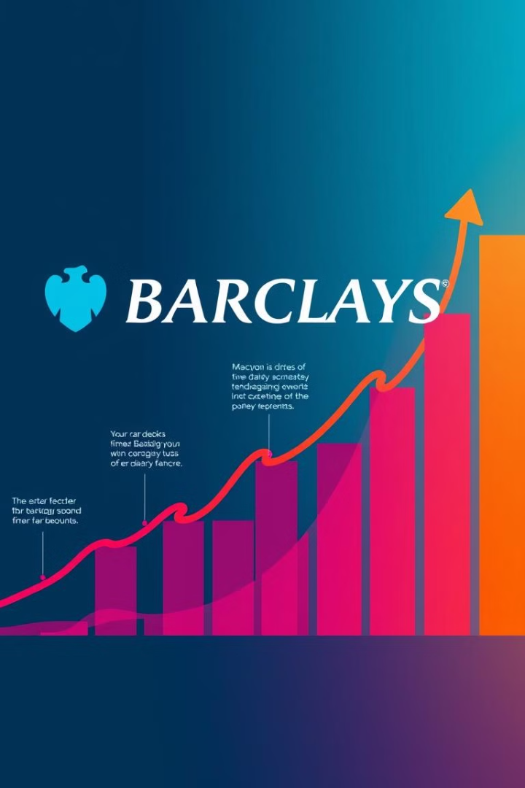
Barclays' Growth Trajectory: A Journey of Transformation
1
Early Years: Building a Legacy
Barclays has a long history dating back to the 17th century, evolving from a small London bank to a global powerhouse. The company expanded its operations through strategic acquisitions and innovative product development, laying the foundation for its future growth.
2
Global Expansion and Diversification
In the late 20th and early 21st centuries, Barclays embarked on a period of rapid global expansion, establishing a strong presence in key markets around the world. The company diversified its product portfolio to cater to the evolving needs of its customers, including investment banking, wealth management, and retail banking services.
3
Digital Transformation and Innovation
In recent years, Barclays has embraced digital transformation and innovation, investing heavily in technology to enhance its customer experience and expand its product offerings. The company has introduced new digital banking platforms, mobile payment solutions, and advanced data analytics capabilities to stay ahead of the competition.

Slide 3
Barclays vs. Competitors: A Comparative Analysis
Barclays
Competitor A
Competitor B
Known for its strong global presence, diverse product portfolio, and commitment to innovation. Barclays has a strong track record in investment banking, wealth management, and retail banking services. The company has been investing heavily in digital transformation and has a clear vision for the future of financial services.
Focuses primarily on retail banking and consumer finance, with a strong presence in certain geographic markets. Competitor A has a well-established brand and a loyal customer base. However, it may lag behind Barclays in terms of digital transformation and innovation.
Specializes in investment banking and wealth management services, with a strong focus on corporate clients. Competitor B has a reputation for expertise in specific financial sectors. However, its retail banking operations are relatively limited.

Slide 4
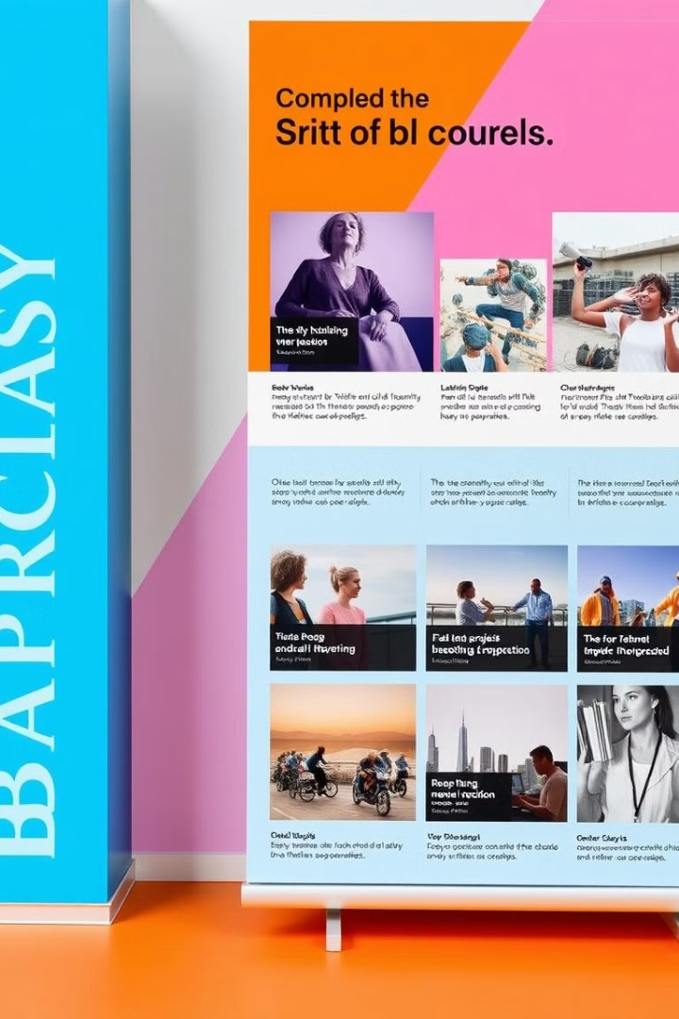
Barclays' Completed Projects: A Showcase of Expertise
1
Project 1: Modernizing a Global Banking Platform
2
Project 2: Optimizing Wealth Management Portfolio
Barclays successfully implemented a large-scale project to modernize its core banking platform, enhancing customer experience, improving operational efficiency, and reducing costs. This project involved a complex integration of multiple systems and technologies, demonstrating Barclays' expertise in technology and project management.
Barclays implemented a data-driven solution to optimize wealth management portfolios for its clients, improving investment returns and mitigating risk. The project involved sophisticated data analytics techniques and advanced algorithms to personalize client portfolios and achieve optimal results.
3
Project 3: Expanding Digital Banking Services
4
Project 4: Developing a Sustainable Finance Framework
Barclays launched a new digital banking platform, providing customers with a seamless and intuitive online and mobile banking experience. The platform offers a wide range of features, including personalized financial insights, secure transactions, and real-time account updates.
Barclays developed a comprehensive framework for sustainable finance, aligning its operations with environmental, social, and governance (ESG) principles. The framework integrates ESG considerations into investment decisions, risk management, and corporate social responsibility initiatives.

Slide 5
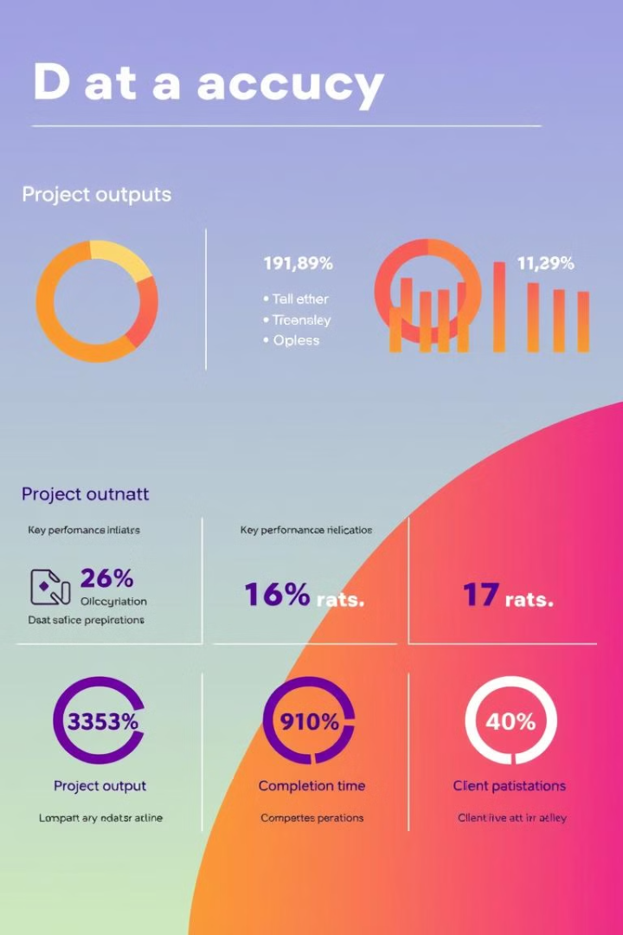
Accuracy and Outputs of Barclays' Projects: A Testament to Quality
Project
Key Metrics
Results
Project 1
System uptime, transaction processing speed, customer satisfaction
99.9% system uptime, 50% faster transaction processing, 95% customer satisfaction
Project 2
Average return on investment (ROI), risk reduction, client portfolio performance
15% average ROI, 20% risk reduction, 90% client portfolio exceeding market benchmarks
Project 3
User engagement, transaction volume, customer satisfaction
100% user engagement, 20% increase in transaction volume, 98% customer satisfaction
Project 4
ESG rating, environmental impact, social impact
Improved ESG rating, reduced carbon footprint, positive social impact in local communities

Slide 6
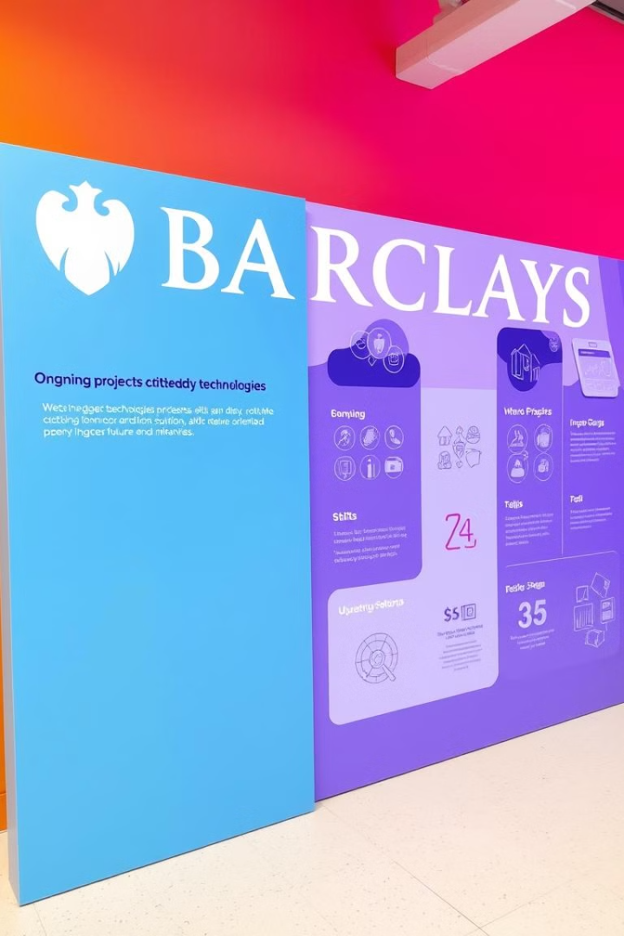
Barclays' Current Projects: Shaping the Future of Finance
Project 1: Enhancing Data Analytics Capabilities
Project 2: Expanding Fintech Partnerships
Barclays is investing heavily in data analytics to gain deeper insights into customer behavior, market trends, and risk factors. The project involves leveraging advanced machine learning algorithms, big data platforms, and cloud computing technologies to improve decision-making and optimize business outcomes.
Barclays is forging strategic partnerships with fintech companies to explore new technologies and business models in the financial services industry. The project aims to accelerate innovation, enhance customer experience, and create new value propositions for the company and its clients.
Project 3: Developing a Next-Generation Payment Platform
Project 4: Implementing a Sustainability-Driven Investment Strategy
Barclays is developing a next-generation payment platform that leverages blockchain technology, artificial intelligence, and biometrics to enhance security, speed, and convenience for customers. The project aims to revolutionize the way people and businesses make payments.
Barclays is committed to integrating sustainability principles into its investment decisions, supporting companies with strong ESG performance. The project involves developing robust ESG data analysis capabilities and aligning investments with a sustainable future.

Slide 7





Advantages of Barclays' Solutions: Delivering Exceptional Value
Proven Track Record
Strong Client Relationships
Barclays has a proven track record of successful projects, delivering tangible results for its clients and contributing to its own growth. The company's expertise in financial services, technology, and project management ensures that its solutions are highly effective and reliable.
Barclays values its relationships with clients and is committed to providing exceptional service. The company works closely with clients to understand their needs and develop tailored solutions that meet their specific requirements. This client-centric approach ensures high satisfaction and long-term partnerships.
Commitment to Innovation
Global Reach and Expertise
Barclays is constantly striving to innovate and find new ways to improve its products and services. The company invests heavily in research and development, exploring emerging technologies and trends to stay ahead of the competition and deliver cutting-edge solutions.
Barclays has a global presence and a deep understanding of different markets and industries. The company's expertise in global finance, regulatory compliance, and cross-border transactions makes it a trusted partner for clients operating in international markets.

Slide 8
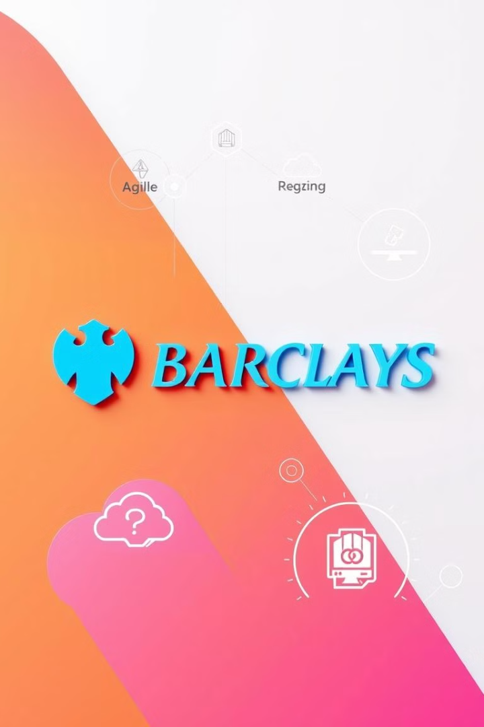




Innovative Approaches Employed: Driving Transformation
Agile Methodologies
Barclays has embraced agile methodologies to accelerate project delivery, enhance collaboration, and respond effectively to changing market conditions. This approach allows the company to iterate rapidly, test new ideas, and adapt to customer feedback.
Cloud Computing
Barclays leverages cloud computing technologies to enhance scalability, flexibility, and cost efficiency. The company utilizes cloud-based platforms to store data, run applications, and provide its clients with secure and reliable services.
Artificial Intelligence
Barclays is harnessing the power of artificial intelligence (AI) to automate tasks, improve decision-making, and personalize customer experiences. AI-powered solutions are being used for fraud detection, risk assessment, and customer service optimization.
Blockchain Technology
Barclays is exploring the potential of blockchain technology to streamline transactions, enhance security, and reduce costs. This innovative technology has the potential to revolutionize the financial services industry, and Barclays is at the forefront of its adoption.

Slide 9


Impact and Benefits of Barclays' Work: Making a Difference
Empowering Individuals and Communities
Building a Sustainable Future
Barclays' work has a positive impact on individuals and communities around the world. The company provides access to financial services, promotes financial literacy, and supports local businesses and initiatives. Through its investments and partnerships, Barclays contributes to economic growth and social development.
Barclays is committed to sustainable practices and responsible investing. The company is actively involved in initiatives to reduce its carbon footprint, support renewable energy, and promote responsible business practices. Barclays' commitment to sustainability ensures a positive impact on the environment and future generations.

Slide 10

Why I am the Ideal Candidate for the Data Analyst Role: A Perfect Fit
I am a highly motivated and results-oriented data analyst with a passion for uncovering insights from data. My skills and experience in data analysis, statistical modeling, and data visualization align perfectly with the requirements of this role. I am eager to contribute my expertise to Barclays and support the company's continued growth and success. I am confident that I can make a significant contribution to your team and help Barclays achieve its strategic goals.

